Slide 1
CASE STUDY
NOW TEST AND APPLY ALL THE TESTING TECHNIQUES ON THE FOLLOWING SOFTWARE
INVENTORY AND ACCOUNTS SYSTEM FOR AUTO
SHOP

Slide 2
The type of documents possible documentations all over the process are following
1) Scope and vision document
2) Requirement elicitation and SRS
3) Software architecture and design documentation
4) Development stages
5) Software testing

Slide 3
Vision of the software
The aim and goal of this software is to build inventory and accounts system for this shop which can handle stock, sales and purchases and account system
Features included are
Customer detail information
Supplier detail information
Product detail information, product stock detail
Customer accounts (debit/credit)
Supplier accounts (debit/credit)
Point of purchase
Point of sale
Sale return

Slide 4
Scope and Limitations
This project will be limited to desktop only, no web base facilities, and one can’t order from home using internet. This project does not contain full accounts system e.g. trial balance, balance sheet, assorts, bank module etc. This project contain only 60 percent reports. Also if light goes during billing and record is not saved, there is no temporary form which contains that data so that we can reload that.
Scope of initial release
This project contain full inventory system and 50 percent accounts, sale and purchase point of sale in detail, but it is limited to shop, either through net or without net it is not online and web base, beside more work is required in accounts section. This project contains more than hundred reports in pdf form. This version does not contain reports of sale and purchase return of a customer, supplier of a specific area. As there is light problem in our country, so it does not contain its solution.

Slide 5
Scope of subsequent release
Version 2 of this software will contain full accounts system. It will contain full reports of accounts, as IST version does not contain full reports because it was not required in IST version, but in second version it will be included. Second version will also solve light problems

Slide 6
REQUIREMENTS FOR THE SOFTWARE
BUSINESS REQUIREMENTS
USER REQUIREMENTS
SYSTEM REQUIREMENTS (Functional / Non Functional)
BUSINESS GOALS/REQUIREMENTS
Today is age of computer and software, time is very fast, you have to face the challenges of digital world, customers and shopkeepers both need fast and reliable system. There were many shopkeepers which use software for their shop and the provides competition. there are a lot of problems and without software it is difficult to handle big shop, so this software will overcome all problems, e.g. robbery from shop, no detail of stock and daily sale etc. and also during zakat month they have to calculate all stock so without software it took much time and rest of business get effected .so by using software it will be easy to handle business

Slide 7
WHAT ARE USER REQUIREMENTS /FUNCTIONAL REQUIREMENTS ?
Customer : customer detail entry by user, record deletion, record updating, record saved.
Supplier : as above
Product stock : product stock entry (product_id,description,quantity,sale_price,purchase_price,avg-price,model-no,part-no,whole-sale-price) :product stock reports like how many specific product remains in stock ? How much stock and amount invested I have ? How much stock for a specific product remain for a quantity less then specified value . So these reports user needs .
Point of purchase : we need purchase module, when we can make entry of product . This form consists of the following two modules 1. purchase main 2. purchase detail
Purchase main consists of invoice_no,invoice date,supplier id and name . While purchase detail consists of invoice_no,product_id,description,model,partno,retailprice,whole price, purchase price,discount rs,discout in percent,total,quantity,net total .
The two modules are related by master and slave relationship by invoice no column .
After the total final, we will subtract the final discount and will enter payment in specified column so that total amount remaining or debited to supplier accounts .
other functionalities involve averaging of price . The stock amount should be updated behind .

Slide 8
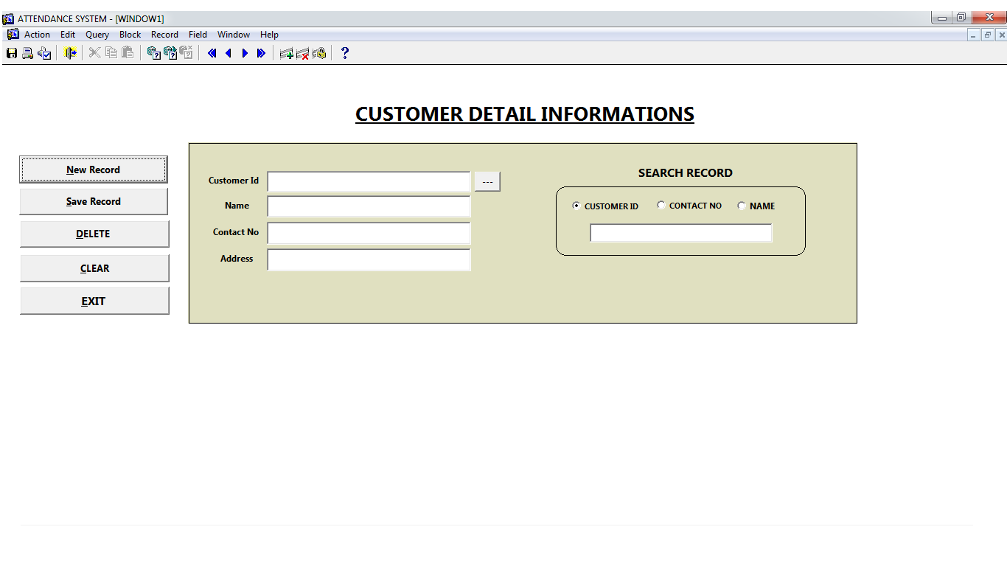
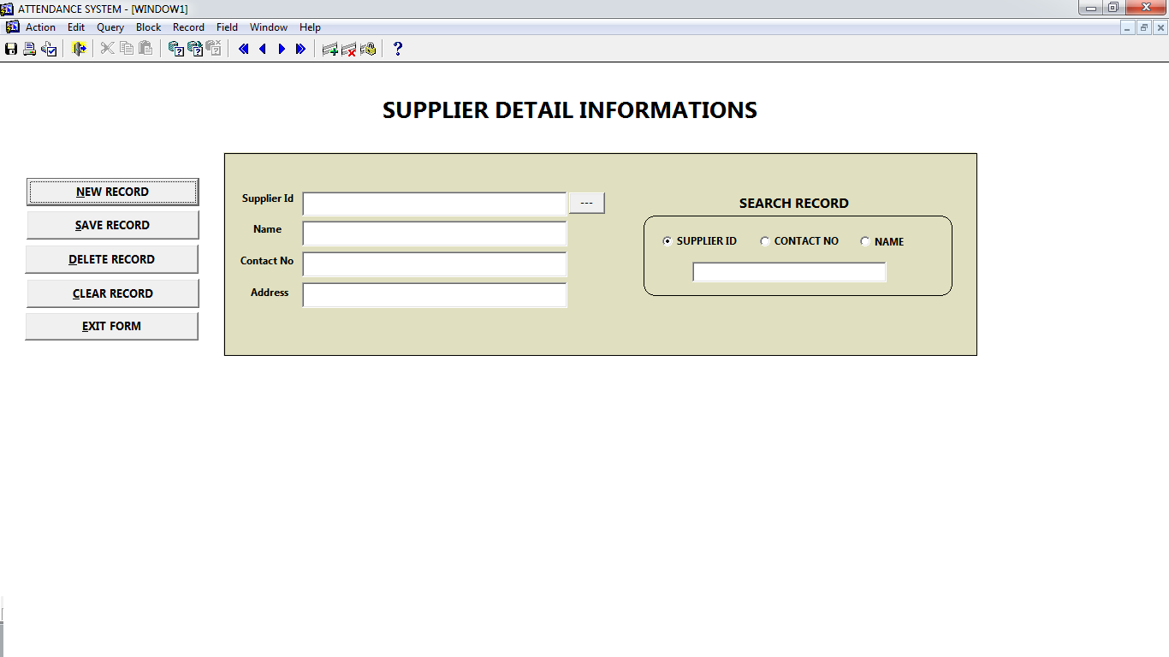

Slide 9
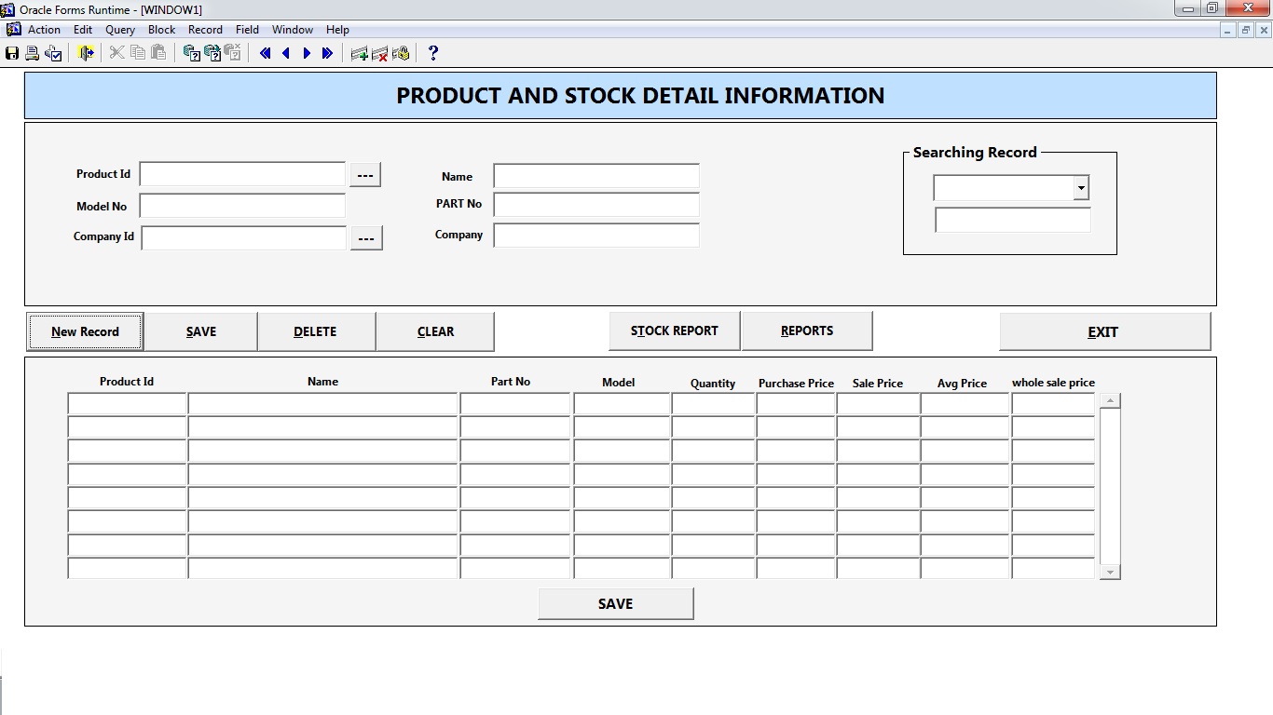

Slide 10
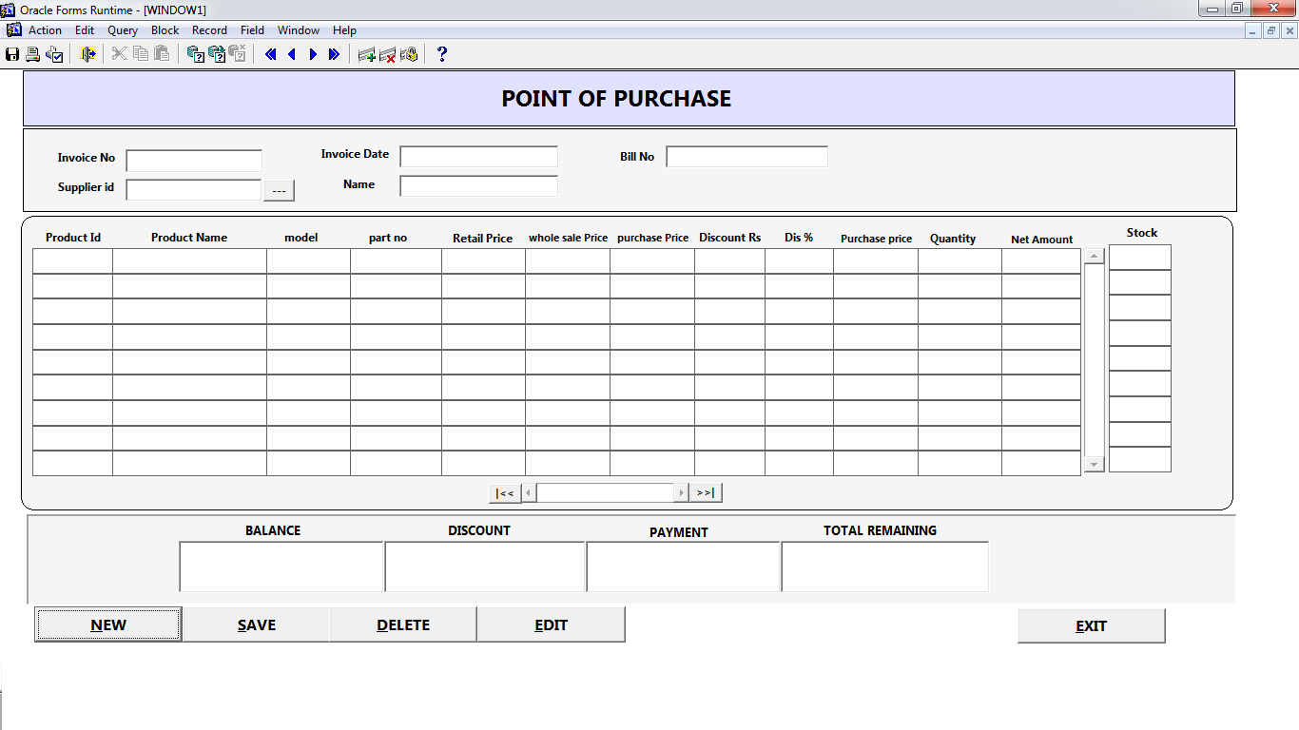

Slide 11
Point of Sale
It consists of two sub modules a) sale main and b) sales detail
sale main contains attributes invoice_no,invoice_date,customer_id,name,previous balance while sale detail consists of product_id,product description,model no,part no,stock,whole sale price, retail price,discount,quantity,net price,total.
It is the main form from where the whole software activities occur . Here we keep record of all sales .
The buttons include new,save,edit,print report.
New is used for starting new record,save is used for saving this record
Save: other functionalities of save include updating product stock quantity,customer_accounts .
Edit : it is used to edit the previous/old record,it will also update customer_accounts and product stock.
This point consists of certain reports like sale report for the current invoice no, sale report for a particular customer in particular duration, sale report as a whole in particular duration for all customers.
This point of sale does not include delete button.
There are certain constraint in this form like if the sale quantity exceeds the amount of quantity in stock then message should display ,either to continue or not .by default customer id will be zero (counter sale) but if the net total of bill is greater then zero then this message should display “please enter customer information's”
If a particular record is saved, and we click the save button again then this message should display “ u have saved your record once”

Slide 12
